Slide 1
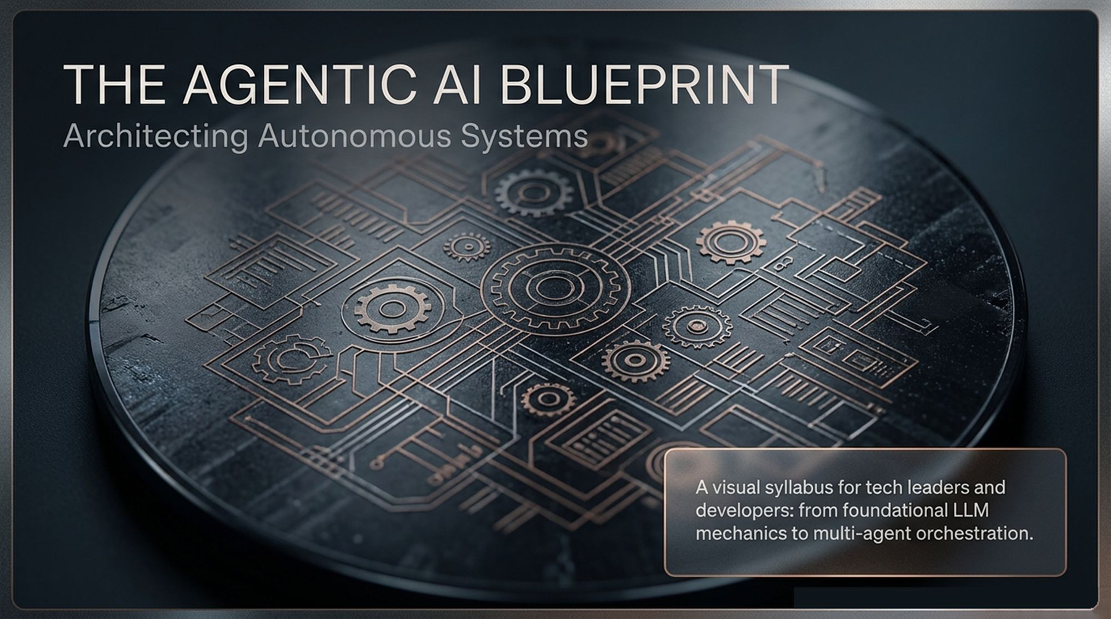
Notes:
Good morning, everyone. Welcome to our masterclass session on Architecting Agentic AI: The Blueprint for Autonomous Systems. Over the next few hours, we are going to embark on a comprehensive technical journey.
If you look at the landscape of Software Architecture today, we are witnessing a fundamental paradigm shift. We are moving away from deterministic, hardcoded programmatic flows toward non-deterministic, goal-driven, and truly autonomous agentic systems.
This deck serves as your visual syllabus and architectural reference. Whether you are a lead engineer, technical architect, or engineering executive, our objective is to bridge the gap between abstract LLM research and production-grade software delivery.
We will systematically break down the journey: starting from the raw mechanics of Large Language Models, extending them into single-agent loops with tools and memory, expanding into stateful execution graphs, evaluating code-agent paradigm shifts, and finally assembling multi-agent orchestrations that power the modern autonomous enterprise.
Let's begin by defining what actually separates a standard Large Language Model from a true AI Agent.
Agentic AI Full Course | Build Real World AI Agents with LangChain, LangGraph, LlamaIndex & CrewAI
https://www.youtube.com/watch?v=MSsqjZ0_GpU

Slide 2
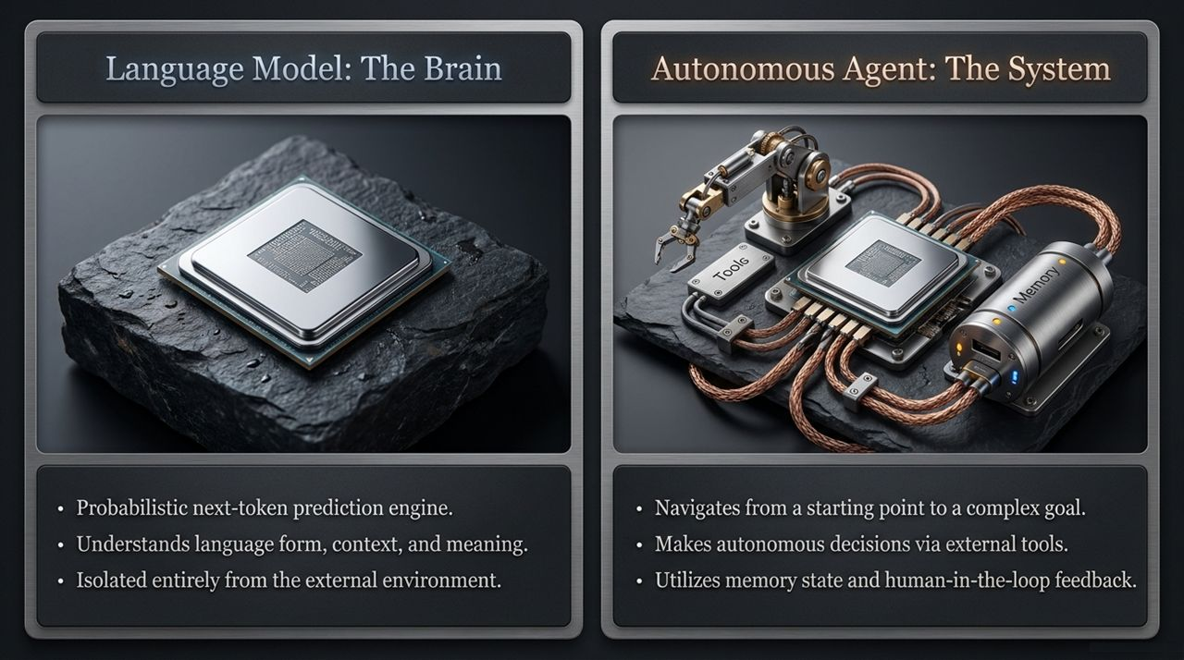
Notes:
To build production-grade agentic systems, we must first establish a strict conceptual boundary between the Brain and the System.
On the left, we have the Large Language Model. At its core, an LLM is a probabilistic, next-token prediction engine. It excels at parsing syntax, understanding semantic context, and reasoning over textual representations. However, it operates in complete isolation from the real world. It cannot query a live SQL database, it cannot execute Python code, and it cannot inspect real-time state without external intervention.
On the right side of the slide, we see the Autonomous Agent. An agent is NOT just a prompt sent to an LLM; it is an entire dynamic software system wrapped around the model.
The agent leverages the LLM as its reasoning core, but surrounds it with three critical architectural components: Tools (acting as hands to manipulate environment state), Memory (acting as state retention across execution cycles), and Human-in-the-Loop triggers (for governance and steering).
While an LLM simply generates static text responses, an Autonomous Agent navigates dynamically from an ambiguous starting condition toward a complex, multi-step goal.

Slide 3
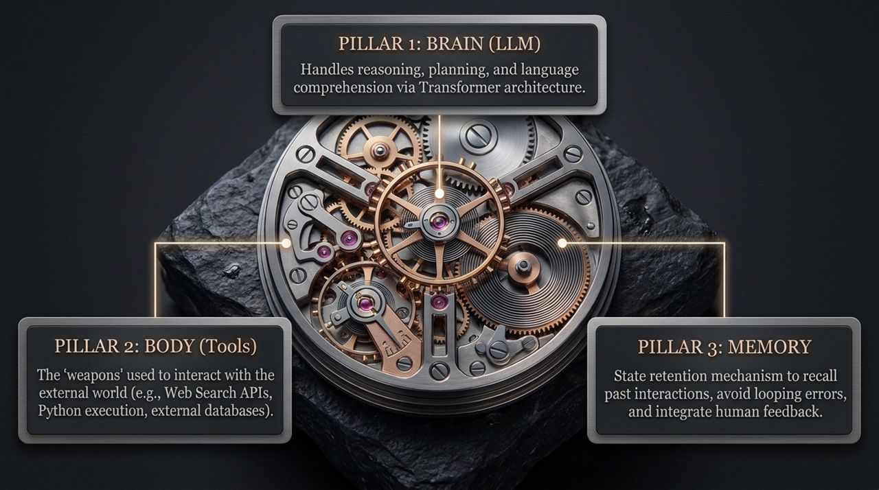
Notes:
When we inspect the inner mechanics of any modern agent system, we consistently find three foundational pillars. Think of this as the anatomy of an agent.
Pillar 1: The Brain (LLM). This component handles high-level cognitive tasks—intent understanding, task breakdown, step-by-step planning, and semantic evaluation. Powered by Transformer architectures, it processes environmental context and decides what to do next.
Pillar 2: The Body (Tools). Tools are the operational 'weapons' or interfaces through which the agent interacts with external systems. This includes REST APIs, web search engines, Python sandboxes, and database query engines. Without tools, the agent is trapped in a pure thought loop.
Pillar 3: Memory & State Retention. To prevent agents from repeating mistakes or falling into infinite logic loops, they require persistent state. This pillar manages short-term contextual memory, long-term semantic stores, and state restoration mechanisms.
When these three pillars operate in unison inside a feedback loop, true autonomous behavior emerges.

Slide 4
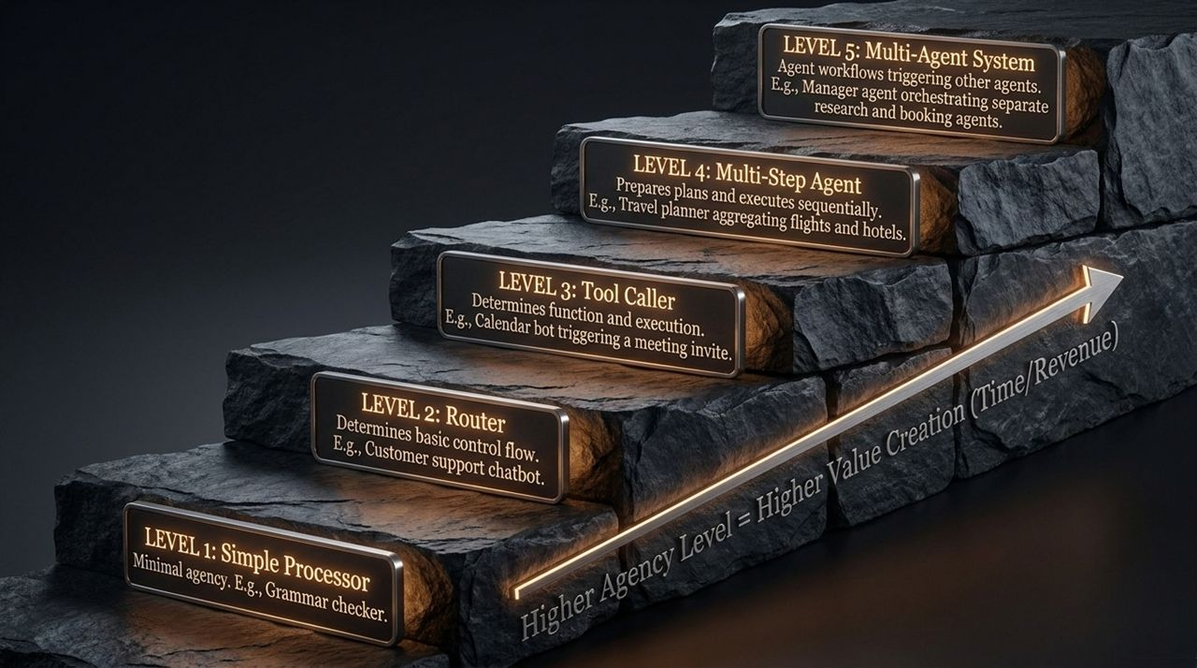
Notes:
Not all AI software is created equal. As enterprise architects, we need a standard framework to evaluate the maturity and autonomy level of our AI implementations. Here, we break down agency into 5 discrete levels.
Level 1: Simple Processor. Minimal to zero agency. Think of basic grammar checkers or stateless classification calls where input directly produces an output without tools or state.
Level 2: Router. The LLM determines basic control flows, directing user input down predefined deterministic branches (e.g., standard triage chatbots).
Level 3: Tool Caller. The agent dynamically decides which function to call and what arguments to pass based on context (e.g., a calendar bot calling Google Calendar API).
Level 4: Multi-Step Agent. The agent creates an internal plan and iteratively executes actions over sequential cycles until a complex goal is fulfilled.
Level 5: Multi-Agent System. Heterogeneous teams of specialized agents collaborate, delegate sub-tasks, and manage shared memory to solve end-to-end enterprise workflows.
As you move up from Level 1 to Level 5, development complexity increases, but the business value creation and labor leverage scale exponentially.

Slide 5
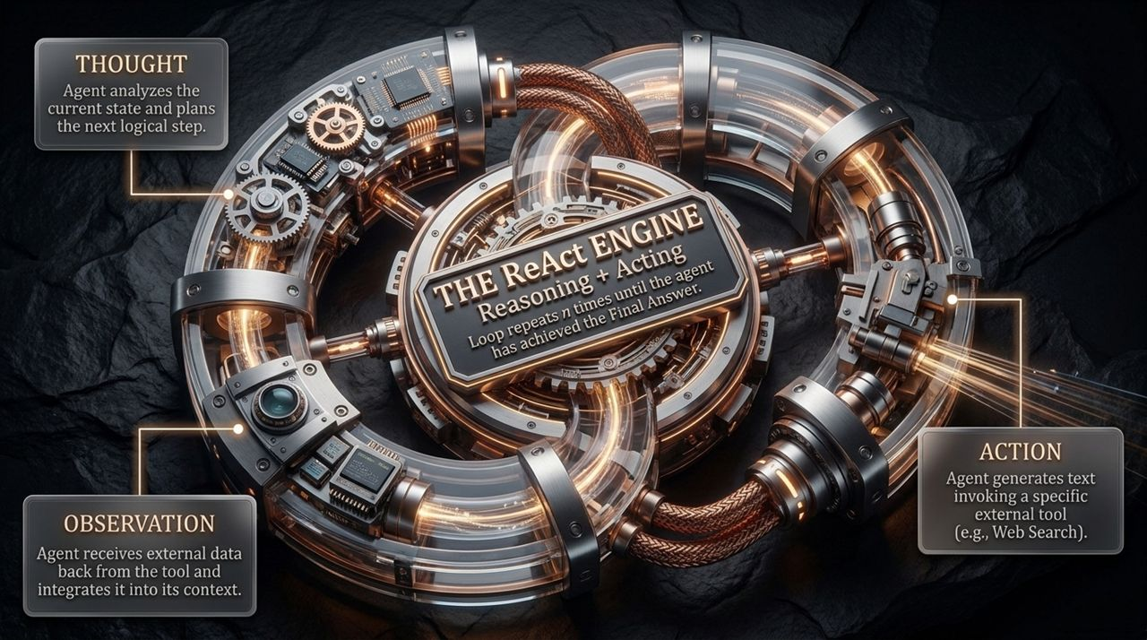
Notes:
At the core of single-agent dynamic decision-making is the ReAct Framework—which stands for Reasoning and Acting.
Instead of forcing an LLM to answer a prompt in a single shot, the ReAct Engine operates an iterative loop driven by three distinct phases:
1. Thought: The agent analyzes the current objective and historical environment state, then verbalizes its next step.
2. Action: The agent outputs a structured decision to invoke a specific tool with generated parameters.
3. Observation: The underlying framework executes the tool call, captures the returned data/error from the environment, and appends it back into the LLM's context window.
This Thought $\rightarrow$ Action $\rightarrow$ Observation loop repeats $N$ times until the agent assesses that the objective is met, issuing its Final Answer.

Slide 6
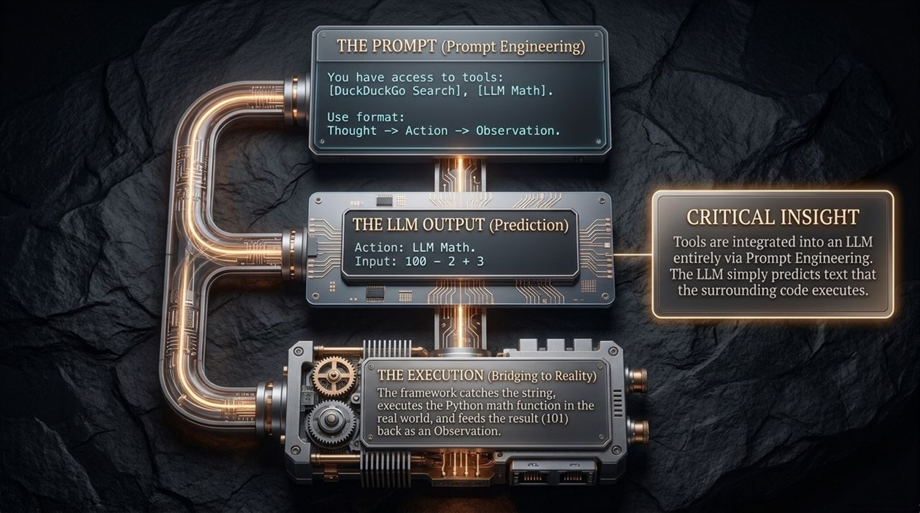
Notes:
Let's demystify how tools actually work under the hood. There is a common misconception that LLMs possess magical direct connections to external databases or APIs.
Critical Insight: Tool integration into an LLM is powered entirely through Prompt Engineering and string parsing.
In phase 1 (The Prompt), we inject a system prompt listing available function schemas and instructing the LLM to output text following a specific format (e.g., JSON or Markdown blocks).
In phase 2 (The LLM Output), the model predicts tokens that output text structured as an action request (e.g., Action: LLM Math, Input: 100 - 2 + 3).
In phase 3 (The Execution), the surrounding Python/TypeScript wrapper framework intercepts this string, matches it to a real Python function, executes the code in the local runtime, and feeds the numerical result (e.g., 101) back into the prompt as an Observation.

Slide 7
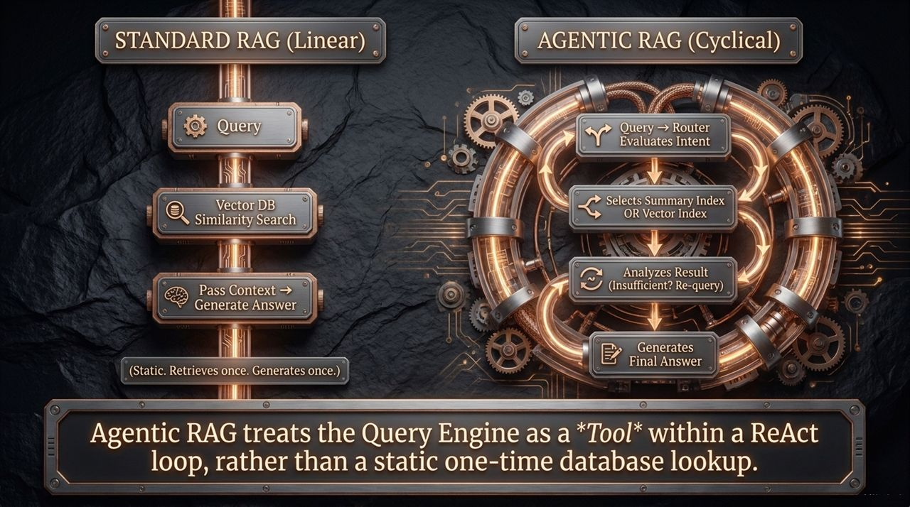
Notes:
Retrieval Augmented Generation (RAG) is standard for enterprise search, but traditional RAG suffers from rigid design limitations.
Standard RAG (Linear): Follows a static, one-way pipeline: User Query $\rightarrow$ Vector Database Similarity Search $\rightarrow$ Context Injection $\rightarrow$ Single LLM Answer. If the retrieved chunks are irrelevant, incomplete, or noisy, the pipeline fails silently with hallucinations.
Agentic RAG (Cyclical): Instead of treating retrieval as a hardcoded static step, Agentic RAG treats the Query Engine as a Tool within a ReAct loop.
An Agentic RAG system evaluates incoming query intent via an intelligent router. It dynamically chooses between summary indices, vector searches, or SQL endpoints. Most importantly, if the retrieved data is inadequate, the agent analyzes the gap and dynamically re-queries with refined search parameters.

Slide 8
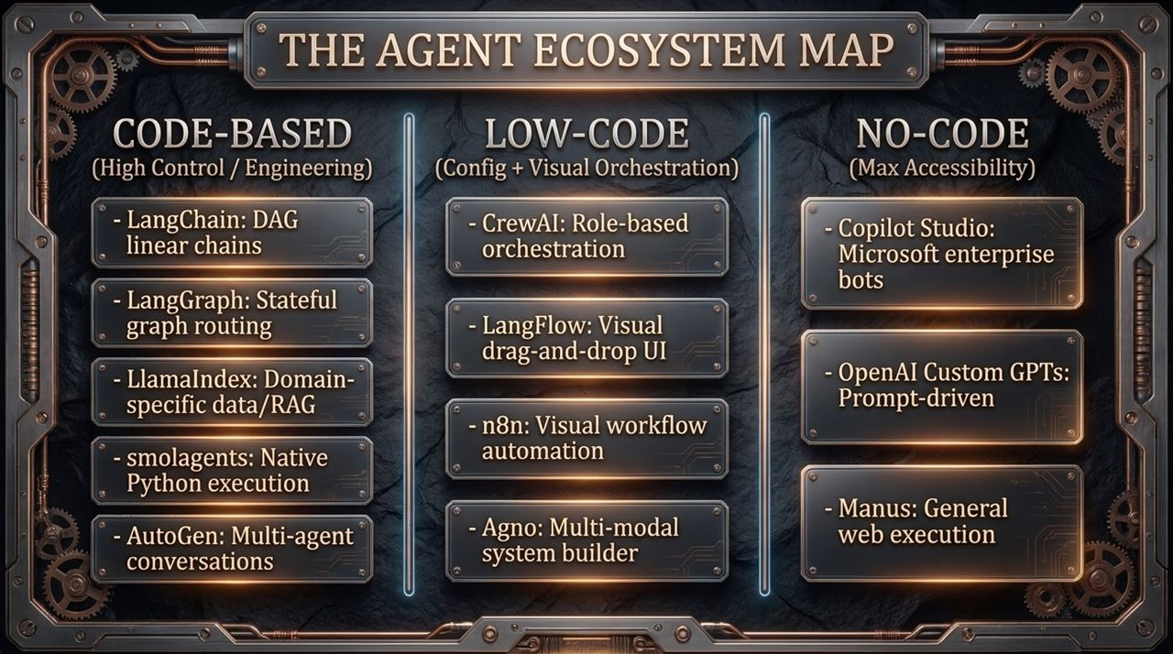
Notes:
As the AI landscape explodes, selecting the right architectural stack can be overwhelming. We can categorize the modern agent ecosystem into three operational paradigms:
1. Code-Based Frameworks (High Control / Production Engineering): Designed for software engineers who require fine-grained state control, deterministic routing, and custom debugging. Examples include LangChain, LangGraph, LlamaIndex, smolagents, and AutoGen.
2. Low-Code Platforms (Visual Orchestration & Prototyping): Enables rapid workflow design using visual interfaces. Examples include CrewAI, LangFlow, n8n, and Agno.
3. No-Code Solutions (Max Accessibility & Business Integration): Targeted at non-developers and enterprise end-users. Examples include Microsoft Copilot Studio, OpenAI Custom GPTs, and Manus.

Slide 9
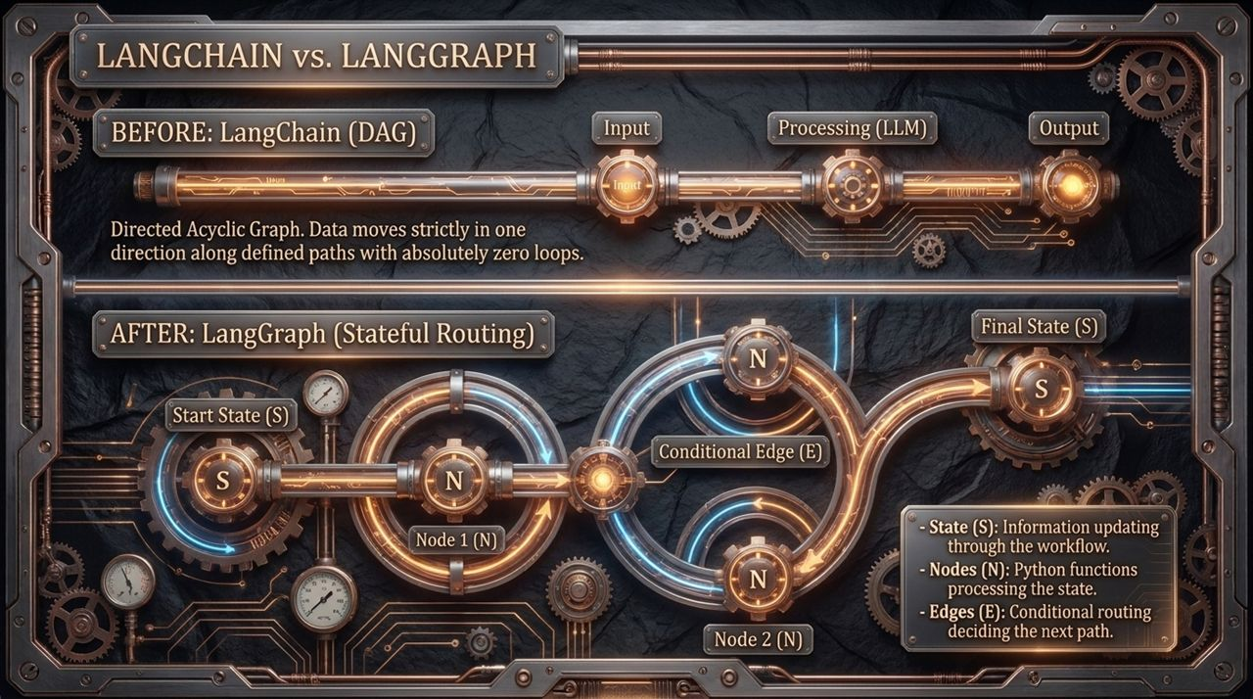
Notes:
To build production systems, understanding the architectural shift from LangChain to LangGraph is essential.
Before: LangChain (DAG - Directed Acyclic Graph). Early agentic pipelines relied on DAGs. Data flowed strictly in one direction from input to output. While great for linear chains, DAGs struggle with unpredictable, looping real-world agent behavior.
After: LangGraph (Stateful Cyclic Graphs). LangGraph introduces stateful cyclic graphs to handle agent orchestration. It models workflows using three primary components:
State ($S$): A centralized, shared data structure updated across execution cycles.
Nodes ($N$): Pure Python functions that receive the current state, perform work/tool execution, and emit state updates.
Edges ($E$): Conditional logic routines that dynamically determine the next node based on current state attributes.

Slide 10
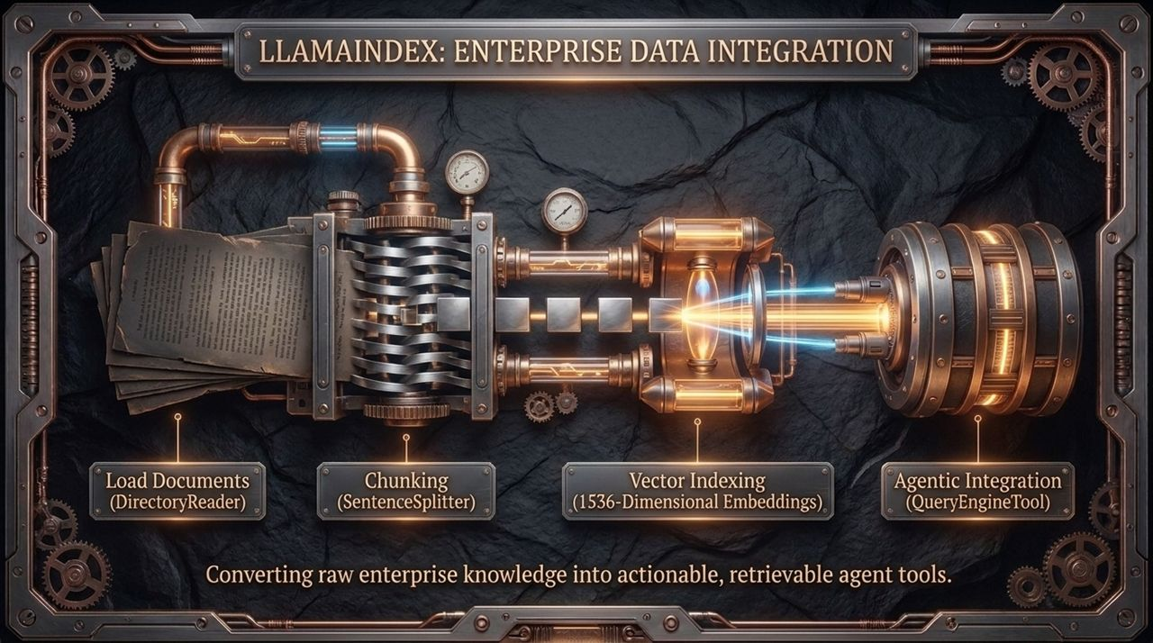
Notes:
While frameworks like LangGraph focus on orchestration, LlamaIndex focuses on structural data integration for complex enterprise data.
Unstructured enterprise data (PDFs, internal documentation, Confluence pages) cannot be directly processed by LLMs without ingestion.
LlamaIndex handles this through a structured 4-step ingestion machine:
Document Loading: Native ingestion via connectors like DirectoryReader.
Chunking: Chunking text using smart splitters like SentenceSplitter.
Vector Indexing: Converting text chunks into high-dimensional vector embeddings (e.g., 1536 dimensions) stored in a vector index.
Agentic Integration: Wrapping indices into query tools (like QueryEngineTool) so agents can search internal enterprise knowledge during execution.

Slide 11
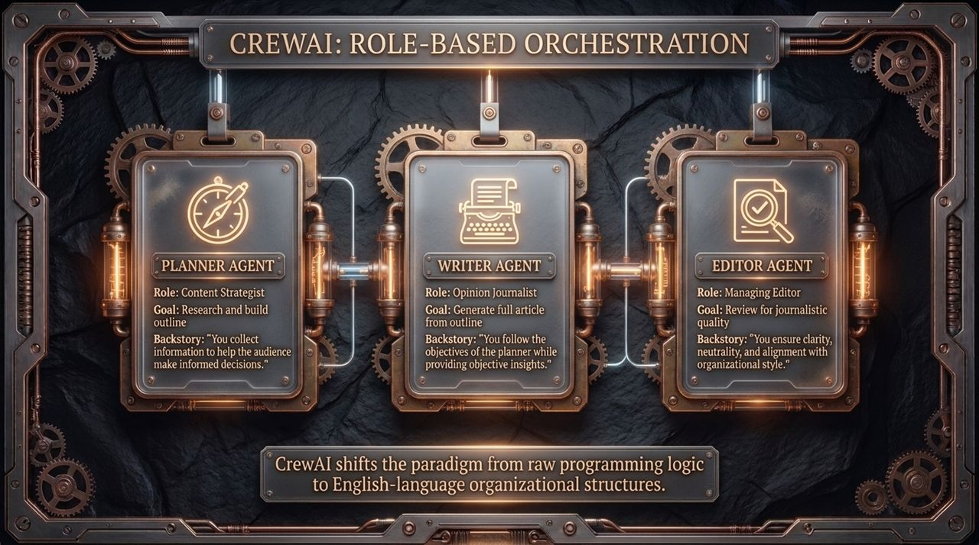
Notes:
When tasks become too complex for a single agent, we transition to multi-agent team abstractions. CrewAI pioneered a human-like organizational paradigm.
Instead of managing raw prompt strings, CrewAI allows developers to define specialized agents using English organizational structures:
Role: The title and identity (e.g., Content Strategist, Opinion Journalist, Managing Editor).
Goal: The specific outcome the agent is driven to achieve.
Backstory: System-prompt context providing perspective, style, and guardrails.
By assigning distinct roles and backstories, agents operate with specialized context, passing structured outputs cleanly to peer agents.

Slide 12
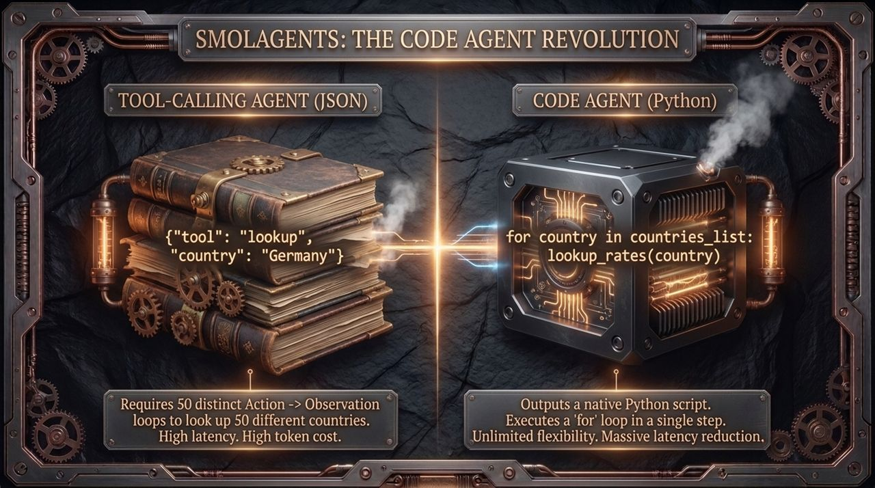
Notes:
A major architectural shift is happening in tool execution: moving from JSON Tool-Calling to Native Code Execution (exemplified by Hugging Face's smolagents).
Tool-Calling Agents (JSON): Standard agents express actions via JSON format. To look up data for 50 countries, the agent must undergo 50 separate Thought-Action-Observation loops. This causes extreme token overhead, high costs, and latency bottlenecks.
Code Agents (Python): Instead of outputting JSON, the LLM outputs native Python scripts containing executable loops (e.g., for country in countries_list: lookup_rates(country)).
This reduces 50 API round-trips to a single execution step, drastically lowering latency, token consumption, and failure rates.

Slide 13
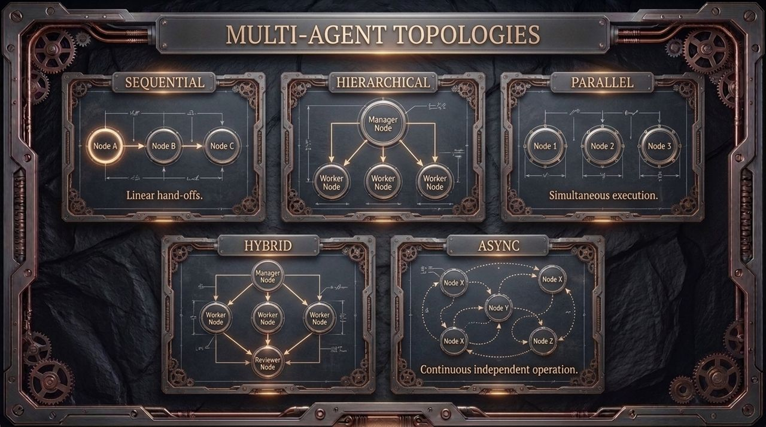
Notes:
When designing multi-agent networks, choosing the right structural topology is critical. We typically utilize five core patterns:
Sequential: Linear pipelines where output from Agent A flows directly into Agent B.
Hierarchical: A top-level Manager Node orchestrates delegation, assigning sub-tasks to Worker Nodes and aggregating results.
Parallel: Independent Worker Nodes execute tasks simultaneously to minimize total latency.
Hybrid: Combines hierarchical orchestration with dedicated Reviewer/QA nodes to validate outputs before finalizing.
Asynchronous (Async): Fully decoupled nodes operating independently across continuous, event-driven state streams.

Slide 14
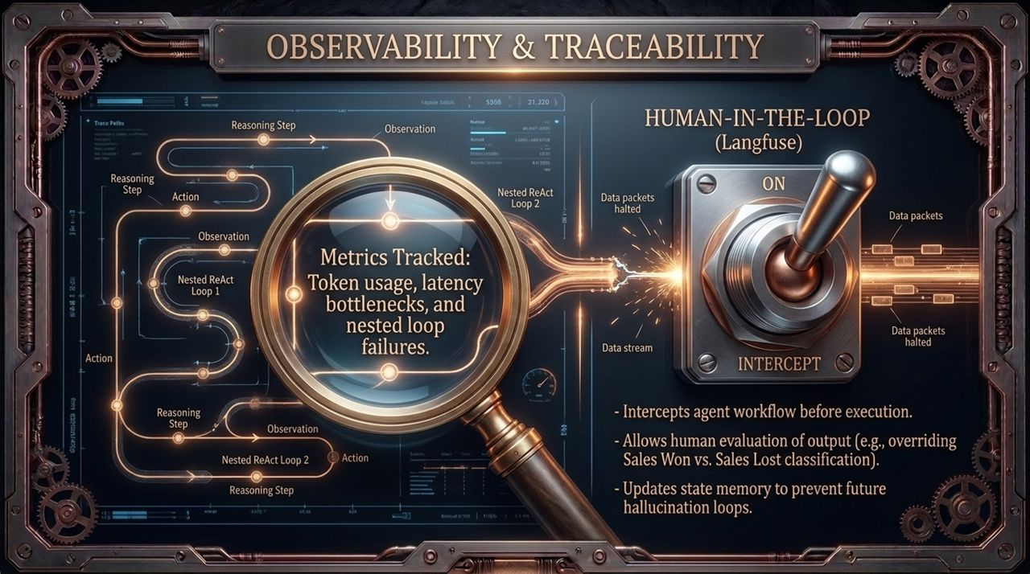
Notes:
Deploying autonomous systems into production without telemetry is a recipe for catastrophic failure.
Tools like Langfuse provide comprehensive observability across nested agent loops. Key operational metrics tracked include:
Exact token consumption per node and sub-task.
Latency bottlenecks across external tool calls.
Failures inside nested ReAct loops.
Crucially, observability enables Human-in-the-Loop (HITL) controls. Mid-execution hooks can pause workflow execution, allowing a human reviewer to inspect or override decisions before state updates persist.

Slide 15
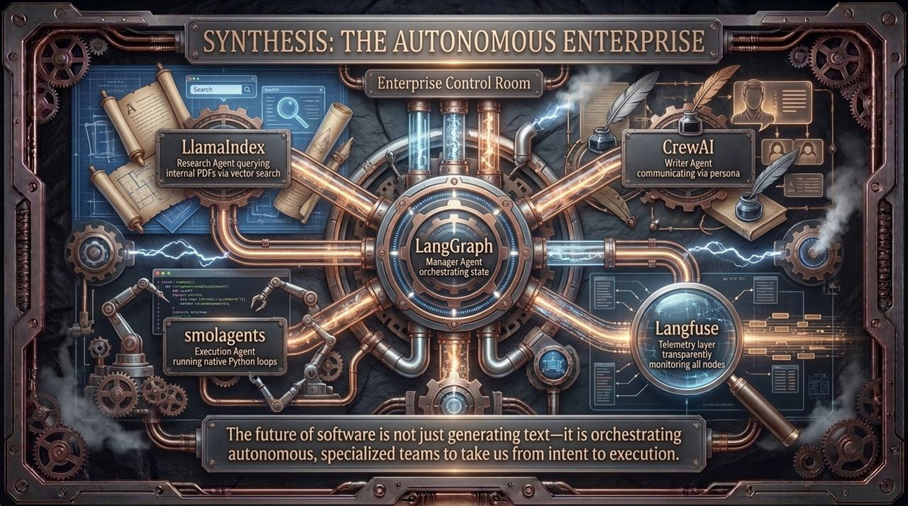
Notes:
Here we bring all these concepts together into a unified Enterprise Architecture.
In a production autonomous enterprise:
LangGraph acts as the core central engine, managing orchestration and global state routing.
Specialized agents handle dedicated domains: LlamaIndex powers internal knowledge retrieval, CrewAI manages persona-driven content generation, and smolagents executes high-speed Python loops.
Langfuse serves as the surrounding telemetry layer, continuously monitoring cost, performance, and safety.
The future of enterprise software is not just generating text—it is orchestrating specialized autonomous teams to take us seamlessly from intent to execution.

Slide 16
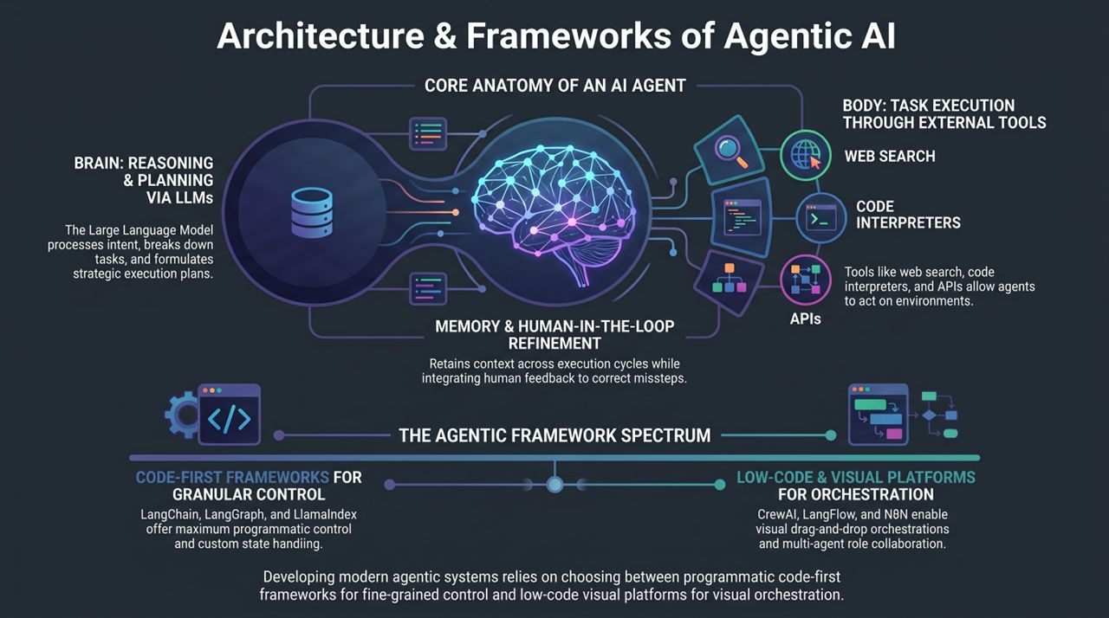
Notes:
To wrap up our architecture review, let's look at the complete spectrum of tools and frameworks.
At the top, remember the core anatomy: the LLM Brain handles reasoning; Memory & HITL preserve long-term context and human alignment; and the Body executes actions via web search, code interpreters, and API integrations.
When choosing your framework stack, evaluate your team's needs across the Agentic Framework Spectrum:
Code-First Frameworks (LangChain, LangGraph, LlamaIndex): Best for maximum control, complex state management, and deep custom logic.
Low-Code Platforms (CrewAI, LangFlow, n8n): Best for rapid prototyping, visual drag-and-drop orchestration, and multi-agent role collaboration.
Thank you for your attention. Let's now open the floor to questions and discuss your specific architectural implementation strategies!
Agentic AI Full Course | Build Real World AI Agents with LangChain, LangGraph, LlamaIndex & CrewAI
https://www.youtube.com/watch?v=MSsqjZ0_GpU

